Slide 1
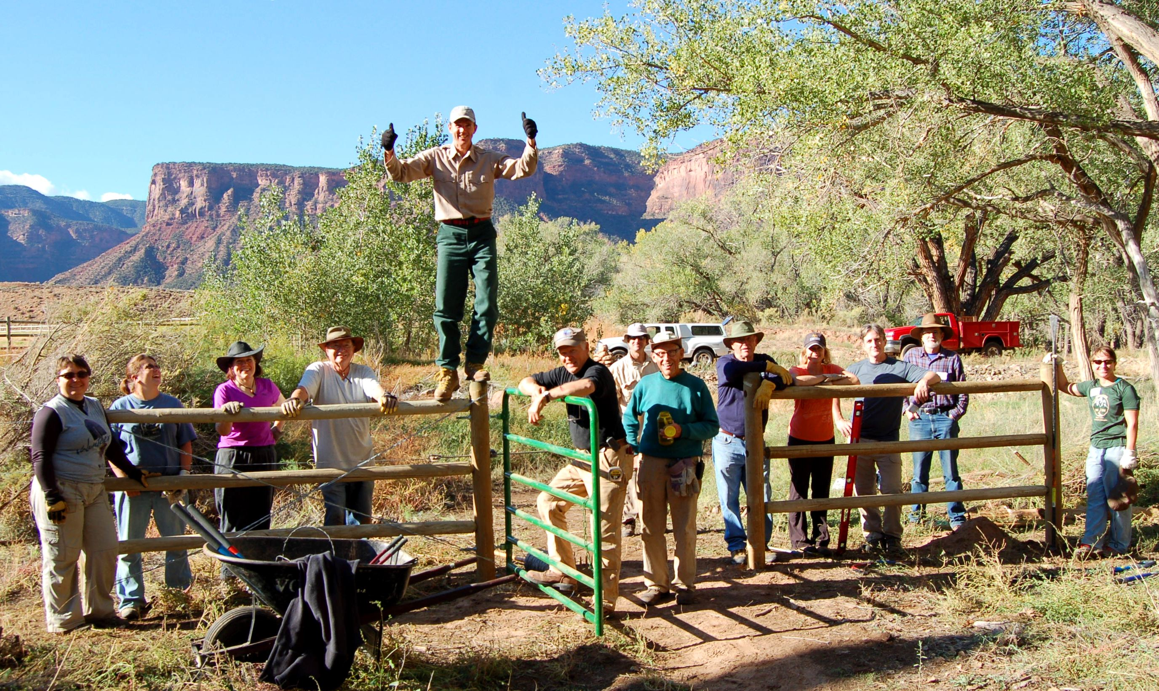
DOLORES RIVER RESTORATION PARTNERSHIP
GATEWAY CANYONS RESORT
VOLUNTEERS FOR OUTDOOR COLORADO
INTERPRETIVE TRAIL CONSTRUCTION
OCT 12 and 13th 2012

Slide 2
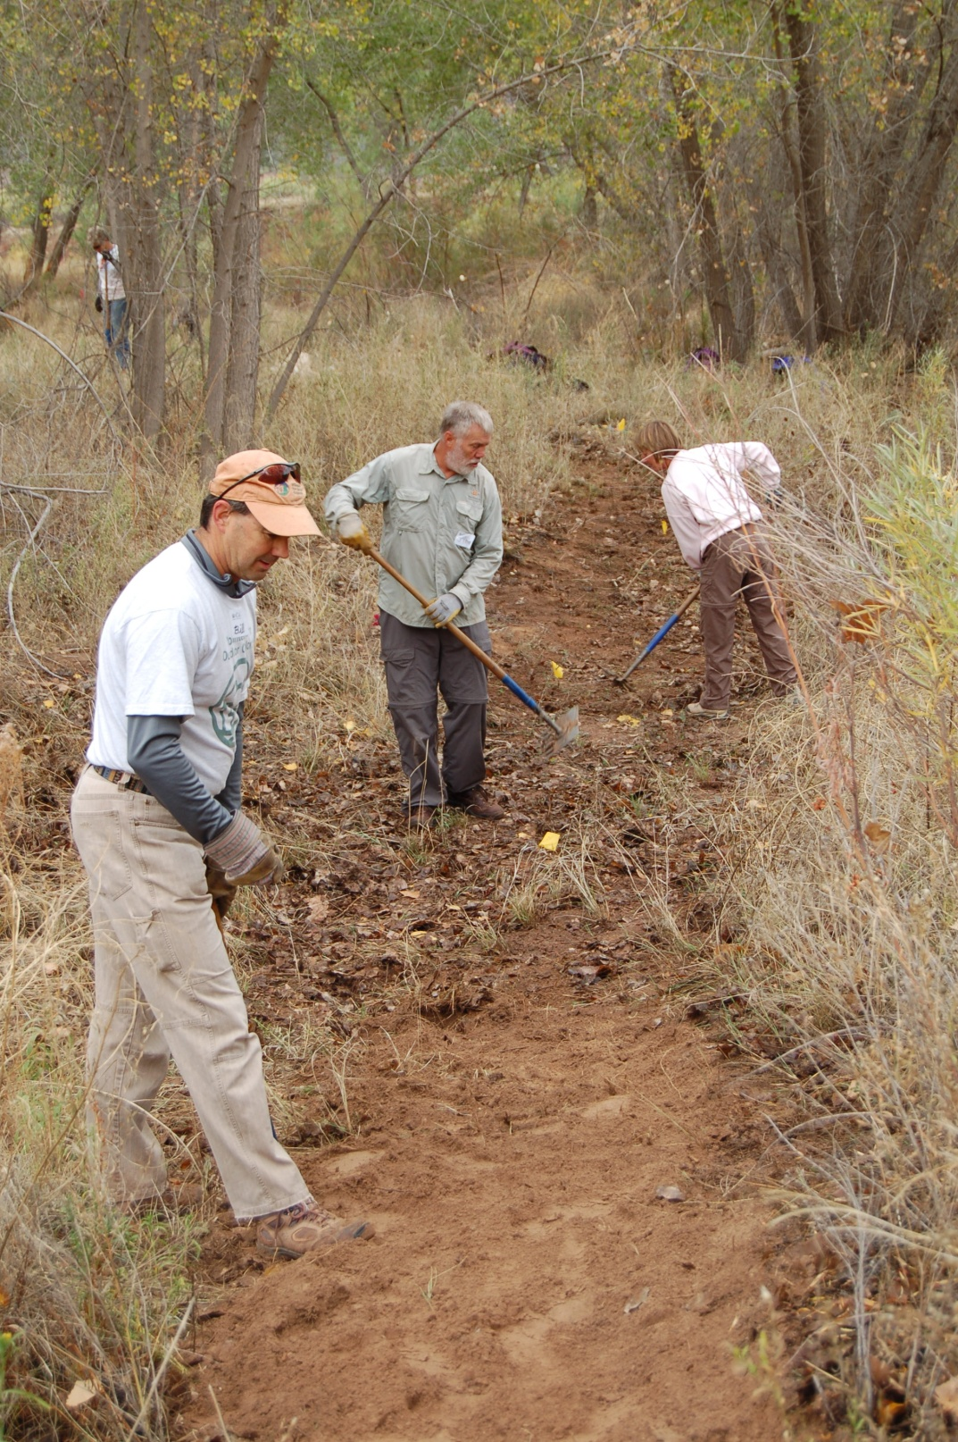
54 Volunteers

Slide 11
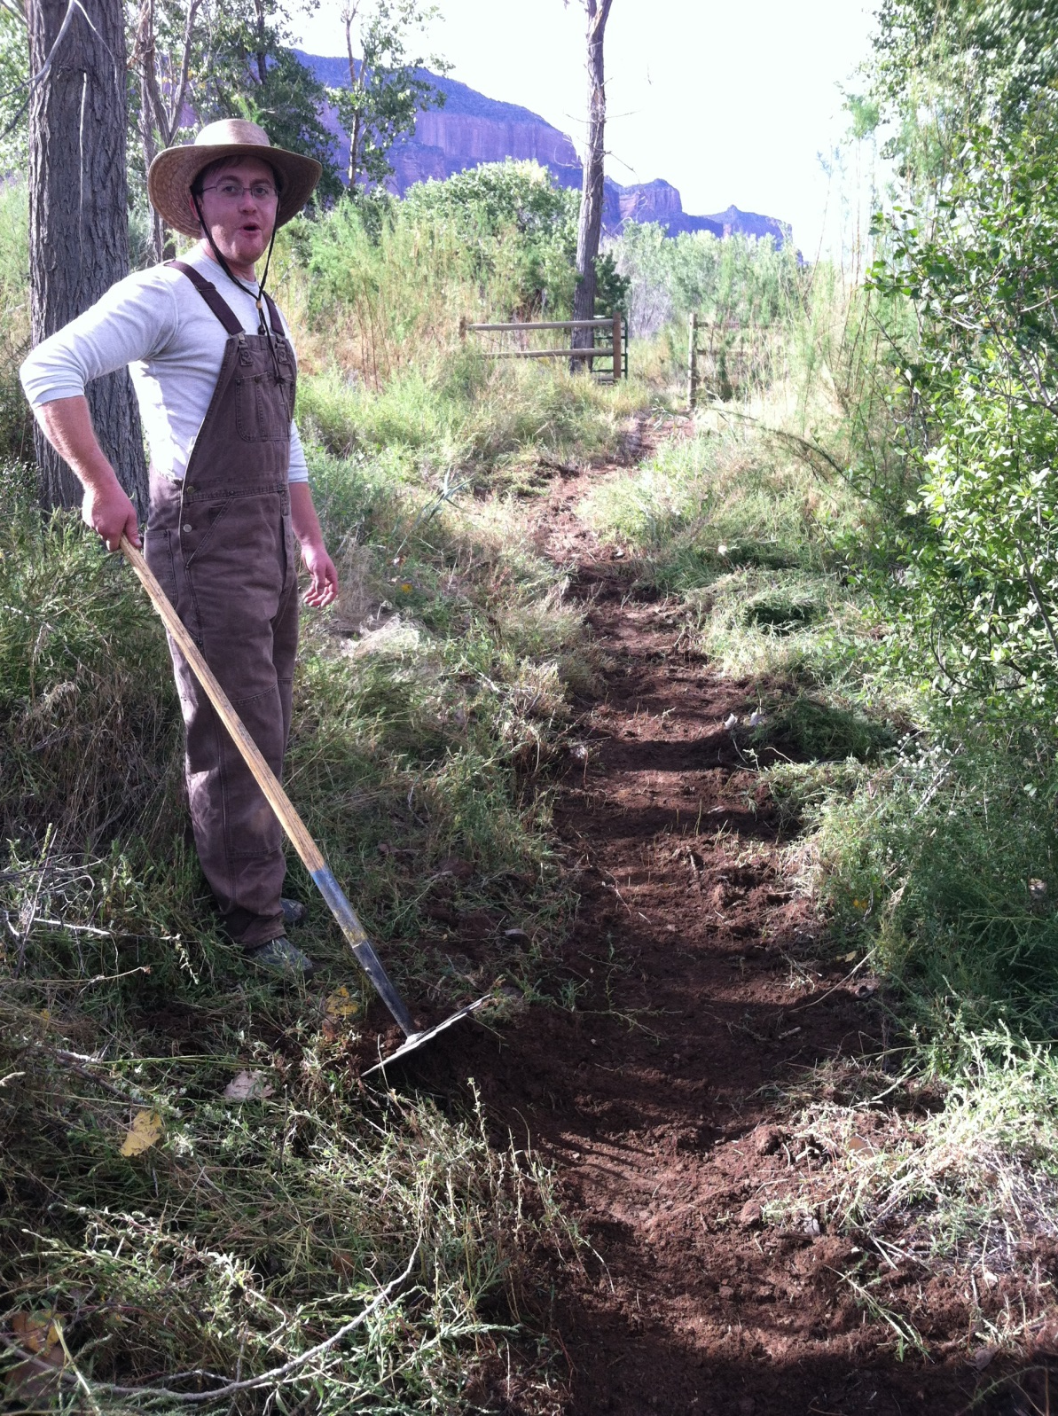

Slide 13
